Slide 1
Meeting Week 10
Last week summary
Simulation
  LPV-LFR format
  Compare against frozen baseline
Augmentation – parameter updating
  Some notes about design choices
Outline ToDo next week

Slide 2
Last week summary
LPV in LFR format
M(Y) invertibility proven with Sylvester’s criterion
Causal chain
  Because of the invertibility of M(Y) this can be resolved
SVD
  The 6-channel scheduling loop Δ(Y)=YI6 can be reduced by an equivalent 4-channel loop Δ(Y)=YI4

Slide 3
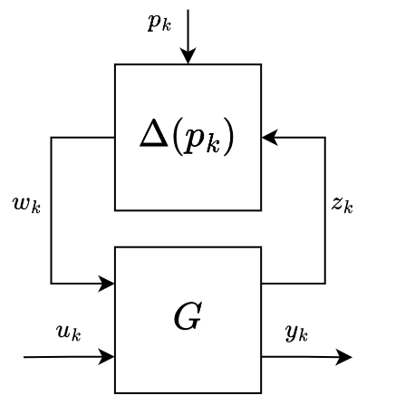
Last week summary
LPV in LFR format
M(Y) invertibility proven with Sylvester’s criterion
Causal chain
  Because of the invertibility of M(Y) this can be resolved
LPV model from García paper in LFR format

Slide 4
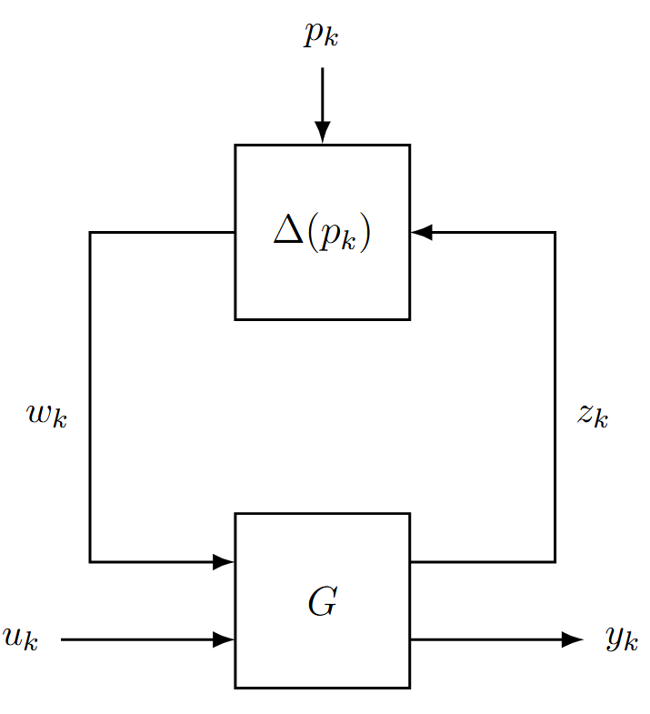
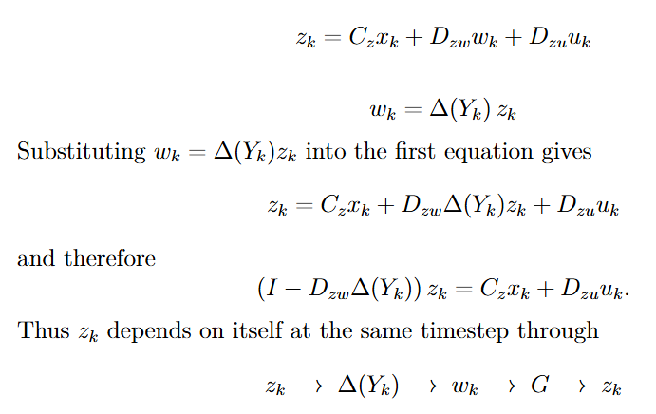
Causal chain

Slide 5
Causal chain
Because of the LFR-structure we have this loop structure
  G uses w
  Delta uses z
    No delay in between

Slide 6
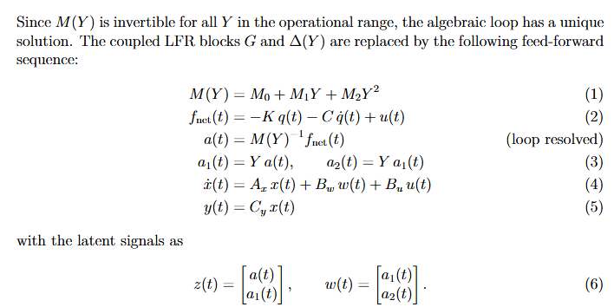
Elimination
Notes:
The LFR structure is preserved because z and w are assembled
and kept explicitly as tensors at the bottom.
Delayed was discussed with Roland but introduces errors
Elimination is mathematically correct but we sacrifice LFR structure

Slide 7
Elimination
Notes:
Use invertibility of M(Y)
The latent signals are dependent on this invertibility
The LFR structure is preserved because z and w are assembled
and kept explicitly as tensors at the bottom.

Slide 8
Elimination
Notes:
Use invertibility of M(Y)
The latent signals are dependent on this invertibility
The LFR structure is preserved because z and w are assembled
and kept explicitly as tensors at the bottom.
---------------------------------------------------
Roland discussed other method: online resolve
Is better at preserving LFR structure
(But for ease / wanting to implement in simulation went with Elimination method)

Slide 9
Elimination – Sacrifices separate Blocks
z and w can be reconstructed exactly after the loop has been resolved.
System is not executed as two separate runtime blocks G and Δ in feedback anymore.
  But the system still come from an exact LFR factorization, with valid latent signals z and w that satisfy the LFR equations.

Slide 10
Simulation – LPV-LFR baseline
LPV-LFR structure: compute x in logical coordinates [X, theta, Y]^T based on given input
Compare against MATLAB output
Metrics used

Slide 11
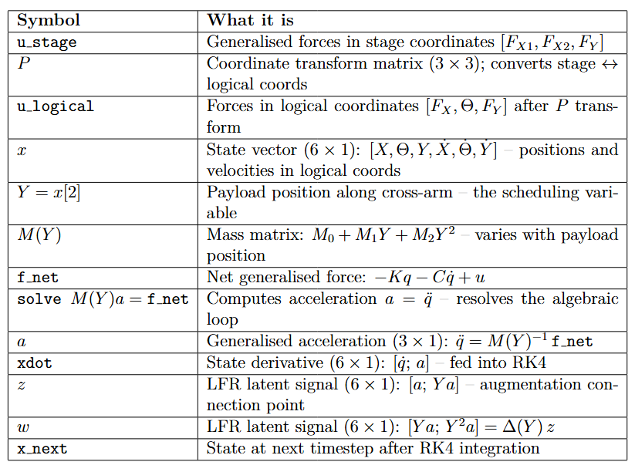
u_stage
P transform
u_transformed
X, Y, Physical parameters
lfr_forward
Solve a = M(Y)^-1 f_net
← M(Y) = M0 + M1 Y + M2 Y^2
Y = x[2] (self-scheduling)
Xdot
z
w
← z, w retained
[x 4 RK4 sub-steps]
X_next
Notes:
Our model is CT LPV-LFR use RK4 to discretize it
The forward solves the “algebraic loop”
Calculate 4 different x states, determine x_next based on that / discretization method

Slide 12
u_stage
P transform
u_transformed
X, Y, Physical parameters
lfr_forward
Solve a = M(Y)^-1 f_net
← M(Y) = M0 + M1 Y + M2 Y^2
Y = x[2] (self-scheduling)
Xdot
z
w
← z, w retained
X0 = [0, 0, 0.3, 0, 0, 0]
[x 4 RK4 sub-steps]
X_next
Notes:
Our model is CT LPV-LFR use RK4 to discretize it
The forward solves the “algebraic loop”
Calculate 4 different x states, determine x_next based on that / discretization method

Slide 13
u_stage
P transform
u_transformed
X, Y, Physical parameters
lfr_forward
Solve a = M(Y)^-1 f_net
← M(Y) = M0 + M1 Y + M2 Y^2
Y = x[2] (self-scheduling)
k1, z, w, y = lfr_forward(x, ...)
x2 = x + (ts / 2) * k1
k2, _, _, _ = lfr_forward(x2, ...)
x3 = x + (ts / 2) * k2
k3, _, _, _ = lfr_forward(x3, ...)
x4 = x + ts * k3
k4, _, _, _ = lfr_forward(x4, ...)
x_next = x + (ts / 6) * (k1 + 2 * k2 + 2 * k3 + k4)
xdot
z
w
← z, w retained
[x 4 RK4 sub-steps]
x_next
Notes:
Also worth noting for the diagram: z and w are only retained
from the k1 call (at the actual state x[k]). The other 3 calls
discard z, w (they get _). So the diagram should show z and w
branching off from k1 only.
- k1: at the current state x[k] — the start of the step
- k2: at x + (ts/2)·k1 — a half-step ahead using k1 as the slope
- k3: at x + (ts/2)·k2 — a half-step ahead using k2 as the slope
- k4: at x + ts·k3 — a full step ahead using k3 as the slope
So k2, k3, k4 are evaluated at temporary/intermediate states
that are never stored — they exist only to get a better estimate
of the average slope over the interval. Then all four slope
estimates are combined:
x_next = x + (ts/6) * (k1 + 2·k2 + 2·k3 + k4)

Slide 14
u_stage
P transform
u_transformed
X, Y, Physical parameters
lfr_forward
Solve a = M(Y)^-1 f_net
← M(Y) = M0 + M1 Y + M2 Y^2
Y = x[2] (self-scheduling)
ts = 1/20000 = 50 μs, corresponding to fs = 20 kHz.
This matches the PLTI (Position Loop Time Interval) from the AccurET hardware specification.
k1, z, w, y = lfr_forward(x, ...)
x2 = x + (ts / 2) * k1
k2, _, _, _ = lfr_forward(x2, ...)
x3 = x + (ts / 2) * k2
k3, _, _, _ = lfr_forward(x3, ...)
x4 = x + ts * k3
k4, _, _, _ = lfr_forward(x4, ...)
x_next = x + (ts / 6) * (k1 + 2 * k2 + 2 * k3 + k4)
xdot
z
w
← z, w retained
[x 4 RK4 sub-steps]
x_next
Notes:
Z,w useful for augmentation, currently not used explicitly
Also worth noting for the diagram: z and w are only retained
from the k1 call (at the actual state x[k]). The other 3 calls
discard z, w (they get _). So the diagram should show z and w
branching off from k1 only.
- k1: at the current state x[k] — the start of the step
- k2: at x + (ts/2)·k1 — a half-step ahead using k1 as the slope
- k3: at x + (ts/2)·k2 — a half-step ahead using k2 as the slope
- k4: at x + ts·k3 — a full step ahead using k3 as the slope
So k2, k3, k4 are evaluated at temporary/intermediate states
that are never stored — they exist only to get a better estimate
of the average slope over the interval. Then all four slope
estimates are combined:
x_next = x + (ts/6) * (k1 + 2·k2 + 2·k3 + k4)

Slide 15
Simulation – Validation
MATLAB output from q1 (Simulink model) vary Y between -0.3 to 0.3 m
  For the plant modeling in python, used u_q1 = C_fb(r − q1) as input to compare.
  Python in open loop; no feedback mechanism. Want to model the plant dynamics
  Used python for frozen baseline with same input u_q1, but Y is “frozen”
Compare LPV-LFR baseline and frozen (without Y-varying) baseline against MATLAB output u_q1
Notes:
The physics in q1 (gantrySystem.m) includes:
- Y-dependent inertia via M(Y)
- Viscous damping C
- Joint stiffness K
- No Coulomb friction
- No Coriolis/centripetal
Frozen baseline in python: Verified python against matlab couple meetings before.

Slide 16
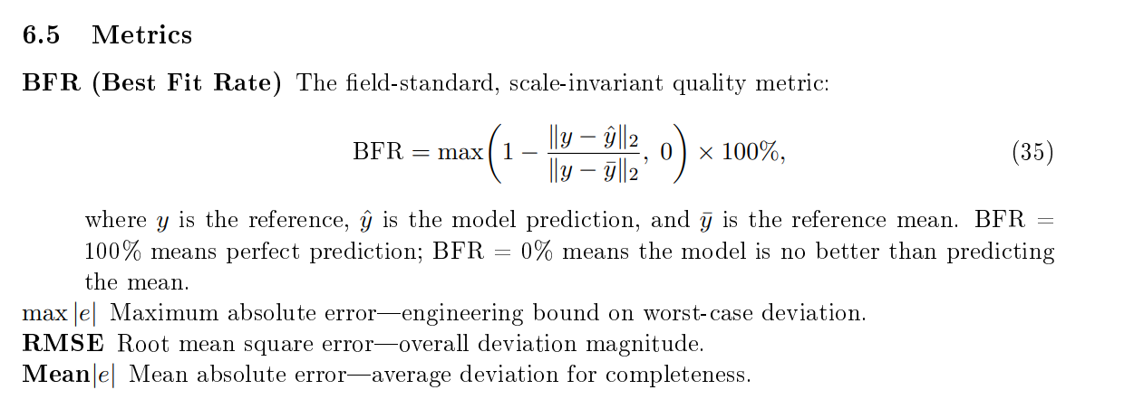
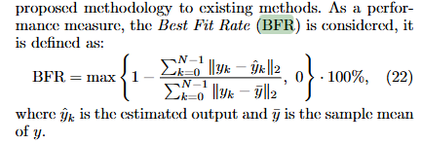
Simulation – Validation metrics
Best Fit Rate (BFR) (scale-invariant, how much better than just predicting the mean of the signal)
Root mean square error (RMSE)
Mean absolute error
Maximum absolute error

Slide 17
Simulation – Trajectory
All models driven by u_q1 forces.
Y range: -0.3 to +0.3 m.
Reference for X1 and X2 are set to zero.

Slide 18
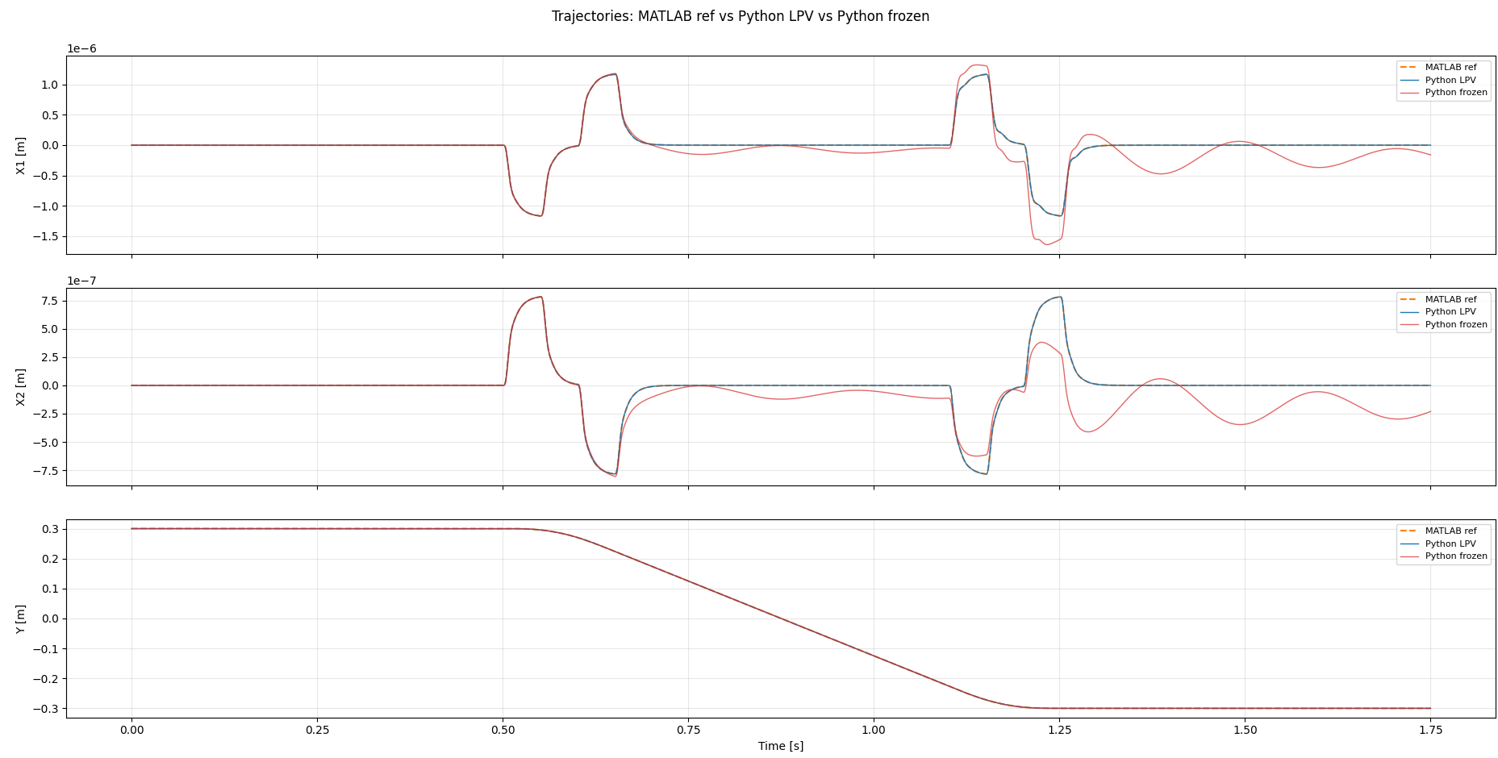
Simulation – Trajectory

Slide 19
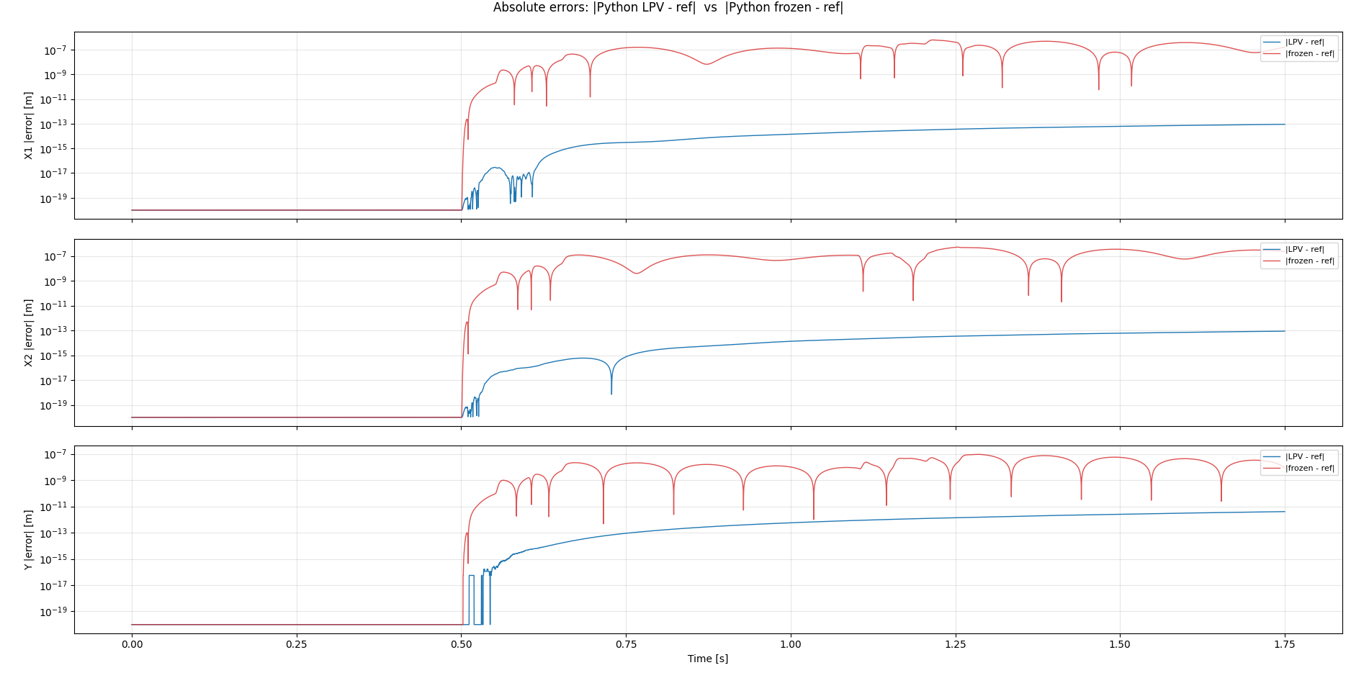

Slide 20
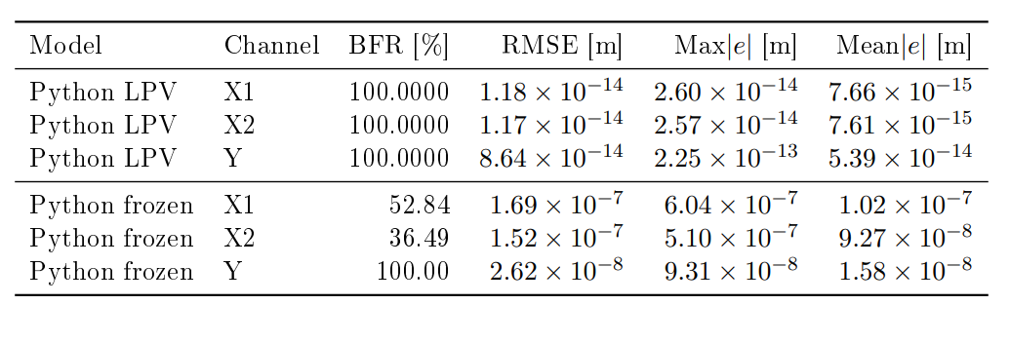
Validation results: Python LPV and frozen LTI vs MATLAB q1 reference. All models driven by u_q1 forces. Y range: -0.3 to +0.3 m.
Reference for X1 and X2 are set to zero.

Slide 21
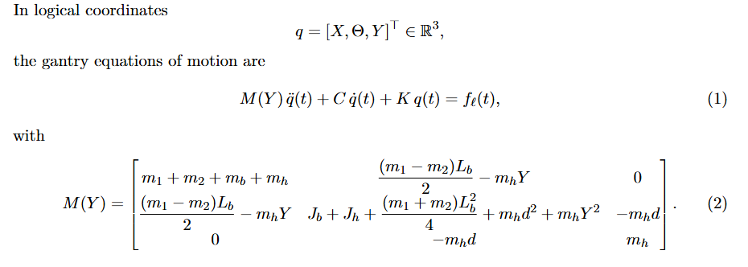
Python frozen high BFR for Y:
Y not expressed in Y
Rounding, with errors in the range of 10^-8: 99.999 circa 100%

Slide 22
Y component corresponds with third row
Python frozen high BFR for Y:
Y not expressed in Y
Rounding, with errors in the range of 10^-8: 99.999 circa 100%

Slide 23
Closed-loop simulation. But off-diagonal coupling terms in M(Y) matrix can cause disturbance forces on X1 and X2.
  → Reason why they are small but not zero
Y: BFR ≈ 100%: Y moves 0.6 m, so even mm-scale errors are tiny relative to the signal. BFR is normalized; RMSE is not.
X1/X2: bad BFR: Position is only ±1 µm (coupling residual). Frozen model errors are of the same order → bad BFR result.

Slide 24
Baseline parameter updating
Currently implementing
Design choices
  Parameters to update: kb_sum, cg1, cg2, cy, cb_sum, mh, m1, m2, mb, J_sum.
    Geometric parameters not included: Lb, Lh, d

Slide 25
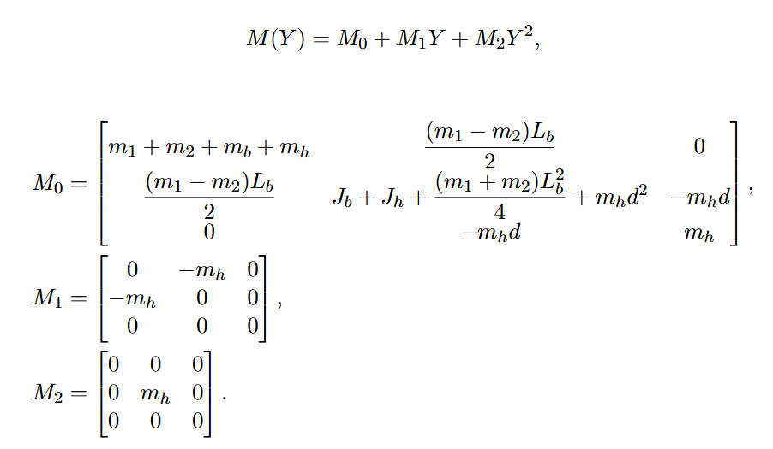
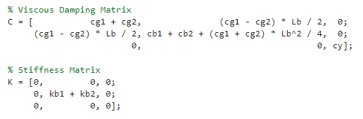
Augmentation – parameter updating

Slide 26
Augmentation – parameter updating
Only appears here and as a sum
→ take relative weak signal

Slide 27
Augmentation – parameter updating
Take the sum for parameter estimation

Slide 28
Baseline parameter updating
Currently implementing
Design choices
  Parameters to update: kb_sum, cg1, cg2, cy, cb_sum, mh, m1, m2, mb, J_sum.
    Geometric parameters not included: Lb, Lh, d
  Log-parameterization
  Precompute state X : [X1, X2, Y, X1_dot, X2_dot, Y_dot]
  Initialization from trajectory (X1, X2 and Y)
    Input data created in matlab with the same model only different parameter values
    The exact values are known
Notes:
(For this step won’t use Jan’s encoder initialization)
qdot[t] = (q[t+1] - q[t-1]) / (2·ts)

Slide 29
Log-parameterization
Why?
→ Ensure the parameters are greater than zero
→ then M(Y) is invertible. Required to determine next state.
And physically meaningful
Wont optimize the parameters directly, but optimize their logarithms; Optimize the log parameters
Before they enter the simulation with lfr_forward convert back with exp(); For physics revert back with exponent
Notes:
Instead of optimizing the parameters directly, we optimize their
logarithms. At each forward pass we apply exp() to recover the
physical values before they enter the simulation. Since exp()
always returns a positive number, masses, stiffnesses, and
dampings are guaranteed positive at every step — keeping the mass
matrix M(Y) invertible and the simulation numerically stable.
1. Forward: exp(log_params) → physical params → M(Y) → simulation → loss
2. Backward: gradient computed w.r.t. log_params
3. Update: Adam changes log_params by some step

Slide 30
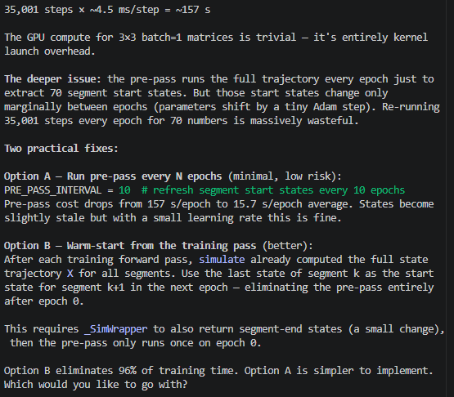
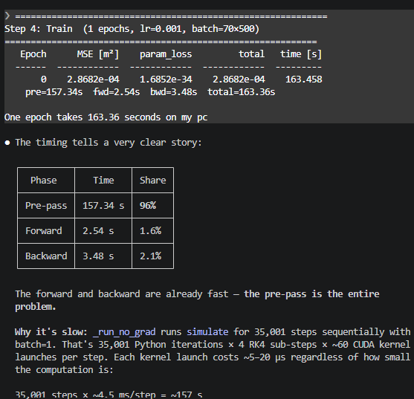

Slide 31
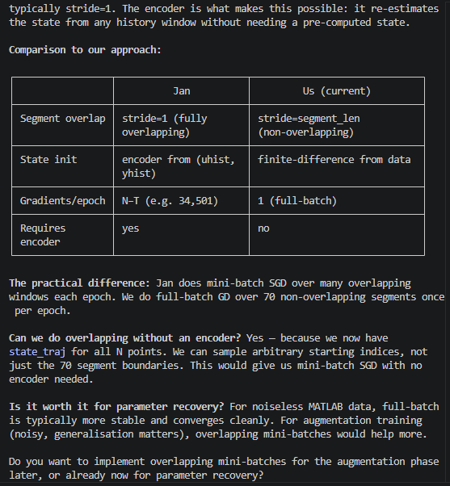

Slide 32
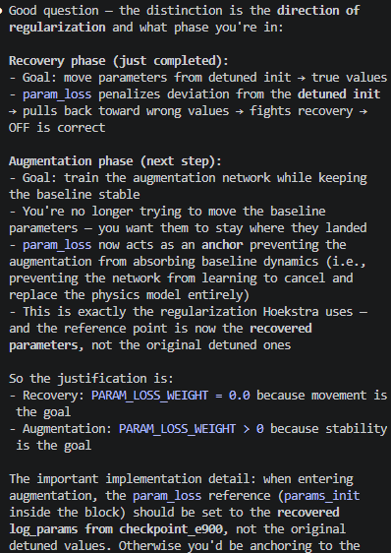
Justification param_loss off

Slide 33
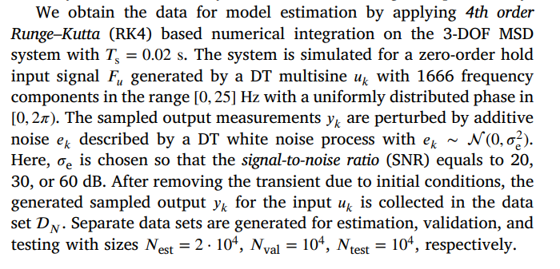
Data generation Jan

Slide 34
Question 1
If a question needs to be answered. Make clear here what the problem/question is that needs to be answered. Questions can always be asked outside the meeting, but we may say prepare to explain what you really mean.
Some figure explaining the concept
When applicable, the same as will go in final report. Otherwise just take screenshots from relevant papers.

Slide 35
Main problem
How to combine / properly make use of current LFR baseline. Don’t have separate blocks
But if I would use the “online resolve” method, could I actually benefit from it?
Jan’s augmentation framework part is additive, so would routing the latent signals add any benefit, especially if I want to apply orthogonality on the baseline. Can I direct the augmentation with the latent signals?

Slide 36
Outline next week
Augmentation
  Parameter updating for the LPV-LFR baseline
  Baseline with additional states to validate augmentation (suggestion from Jasper)

